Slide 1
BCOG 100
Memory, Simulation, & Generative Models
Lecture 1: The Evolution of the Cortex

Slide 2
Reading Check 9-1
Password: memory
Question: What is memory? (according to the article you read)

Slide 3
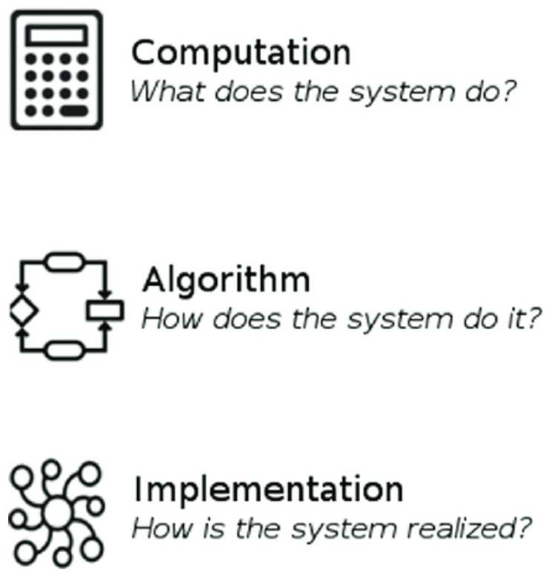
The Evolution of the Cortex
Recap & Overview
Last Time:
Spatial cognition as the basis for memory
Today:
Prediction takes center stage
brain evolved to anticipate the world farther into the future.
Simulation—imagining before acting—was the next great leap.
Notes:
Over the past several weeks, we’ve watched the brain’s history unfold as a long process of learning to predict.
The earliest nervous systems could do almost nothing beyond reflex—sense a stimulus and respond instantly.
That simple loop was enough for survival in the simplest animals, but it offered no flexibility.
Then vertebrates evolved the ability to predict rewards, learning which actions led to good or bad outcomes.
That was reinforcement learning—the beginning of brains that could learn from experience rather than just react.
But this predictive horizon was still short.
A fish or a lizard could predict a few moments into the future, but only through direct trial and error.
Every mistake had to be made in the real world.
Early mammals changed that.
They acquired the capacity to imagine outcomes before they happened—to mentally simulate actions and choose among them.
That innovation—learning before acting—was as profound as the first neuron or the first synapse.
In this lecture, we’ll ask a functional question:
Why did simulation evolve?
What pressures of environment, metabolism, and behavior made it so valuable that natural selection reshaped the brain around it?
By the end, we’ll see that this was the evolutionary moment when mind began to look ahead—when thought itself was born.

Slide 4
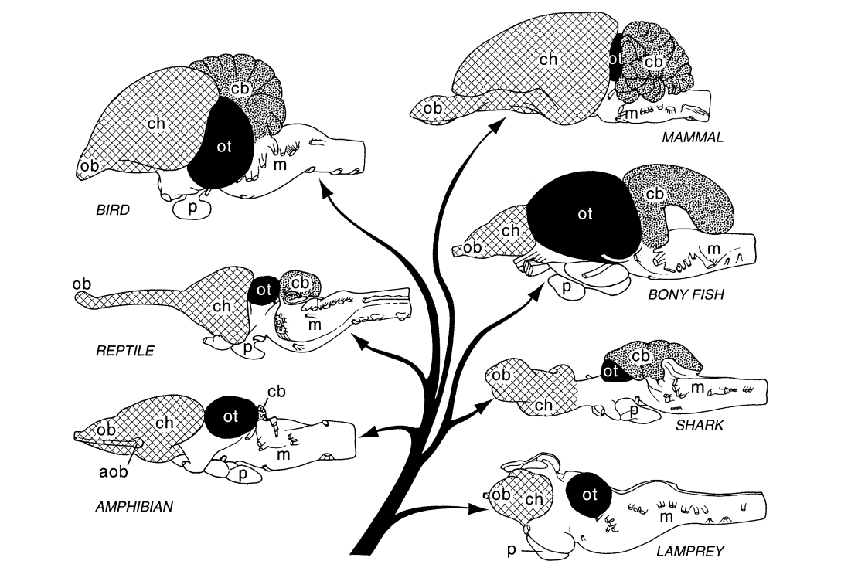
The Evolution of the Cortex
The Neural Dark Ages
For hundreds of millions of years, vertebrate brains barely changed.
Evolution focused on bodies, not minds.
The cortex lay dormant—until mammals rewired it for imagination.
Notes:
After the first great explosion of neural innovation in early vertebrates,
brain evolution entered a long pause—a kind of neural dark age.
From fish to amphibians to reptiles, the basic blueprint stayed nearly the same.
A small forebrain handled smell and basic associations,
the midbrain handled reflexes, and the hindbrain handled movement and balance.
Learning happened mainly through reinforcement: try something, get feedback, adjust slowly.
It worked well enough, and so evolution focused elsewhere—on armor, teeth, lungs, and legs.
Brains did not need to get smarter; bodies did the adapting.
That’s why, even today, the brain of a modern reptile looks surprisingly like that of an ancient fish.
The cortex existed, but it was primitive
—three simple layers, handling pattern recognition and basic spatial mapping.
For nearly two hundred million years, it was little more than a reflex amplifier.
But evolution doesn’t stop forever.
When the world changed—when extinctions wiped out ecosystems and new challenges appeared
—those stagnant brains faced a reckoning.
The species that survived would not be those with stronger armor or sharper teeth,
but those that could think ahead.
And that moment, in the shadow of extinction, set the stage for a new kind of brain
—the mammalian brain—that would use its cortex not just to sense the world, but to simulate it.

Slide 5
The Evolution of the Cortex
Event | Approx. age (Mya)
End-Ediacaran biotic turnover | ~550
Cambrian Explosion | ~540
Origin of vertebrates (jawless fish) | ~520–500
End-Ordovician mass extinction | ~444
Evolution of jawed fish | ~430–420
Late Devonian mass extinction | ~372–359
Evolution of land vertebrates (early tetrapods) | ~375–360
End-Permian mass extinction | ~252
Evolution of mammals (mammal lineage diverges from reptilian lineage) | ~220–200
End-Triassic mass extinction | ~201
End-Cretaceous mass extinction | ~66
Radiation of mammals | ~60

Slide 6
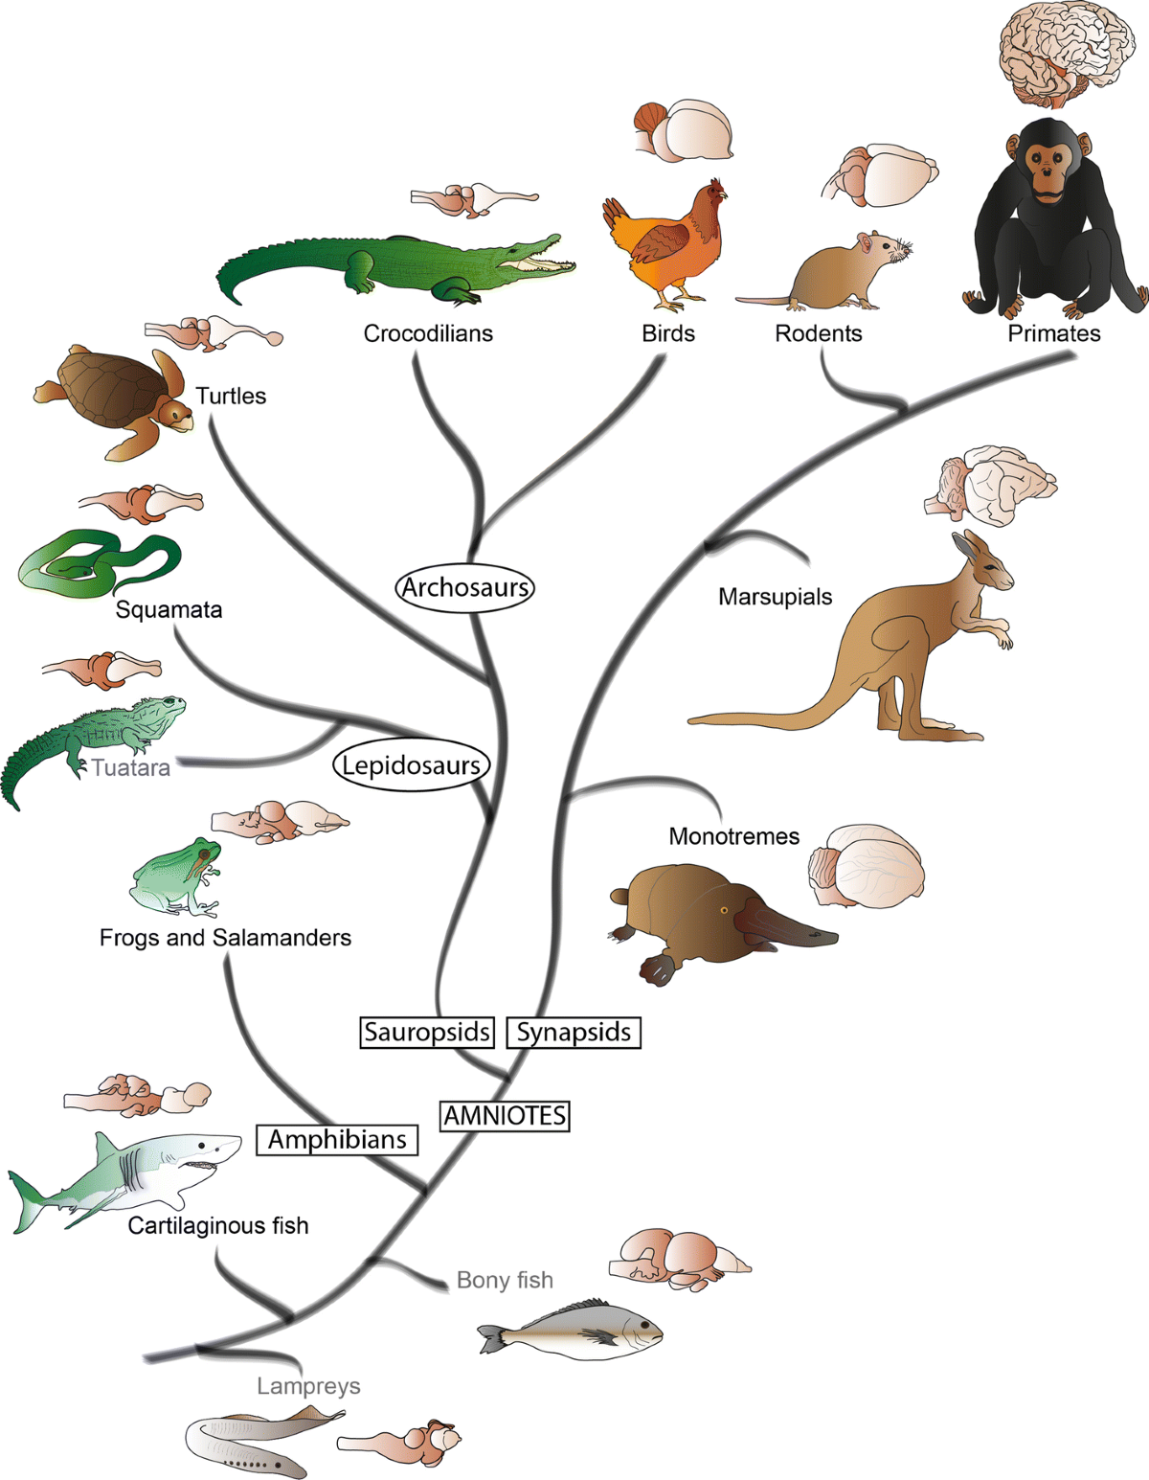
The Evolution of the Cortex
Life on Land and the Rise of the Amniotes
Leaving the water demanded new kinds of control.
Land animals needed brains that could plan movement, not just react.
The amniote brain laid the groundwork for flexible behavior.
Notes:
When vertebrates left the water, the world became radically more complex.
In the sea, motion is smooth and continuous—swimming, drifting, adjusting.
On land, movement became discrete and risky: you could fall, stumble, or be trapped.
Every action had consequences that couldn’t simply be undone.
Suddenly, organisms needed to plan sequences of movements in advance.
The evolution of the amniotes—reptiles, birds, and mammals—brought huge changes to the brain to meet these demands.
They developed new sensory integration areas for vision, balance, and proprioception, giving them a stable internal sense of where their body was in space.
The forebrain grew in importance, coordinating complex, multi-step actions like stalking prey, digging burrows, or caring for offspring.
Still, these early amniote brains were largely reactive.
They could store patterns of successful movement, but they couldn’t yet model how those movements related to unseen causes.
They lived in the moment—responding, adjusting, reacting.
To truly dominate land, some lineage would need to break free from this tight coupling to the here and now.
They would need to build an inner representation of the world—something they could manipulate mentally before taking action.
That innovation would arrive much later, deep in the shadows of the Mesozoic era.

Slide 7
The Evolution of the Cortex
Warm-Bloodedness and Its Cognitive Costs
Feature | Endothermy (Warm-Blooded) | Ectothermy (Cold-Blooded)
Activity Level | Can remain active in cold or dark | Activity limited by ambient warmth
Reaction & Processing Speed | Fast neural conduction; rapid, sustained movement | Slower reactions in cool environments
Ecological Advantage | Expanded temporal niche (e.g., nocturnal, cold-weather activity) | High efficiency in stable, warm climates
Energy Demand | Extremely high | Low, energy-efficient
Growth & Reproduction | Requires continuous energy intake; fewer offspring | Can survive long periods without food
Cognitive Potential | Supports sustained neural activity | Limits prolonged complex cognition
Evolutionary Trade-Off | Speed and flexibility at high cost | Efficiency and simplicity at low cost
Notes:
The next great shift wasn’t just behavioral—it was metabolic.
As some reptiles evolved into early mammals,
they began generating their own heat instead of relying on the environment.
This shift to endothermy, or warm-bloodedness, was an extraordinary advantage.
Warm-blooded creatures could stay active at night,
hunt in cold weather, and react faster than their cold-blooded rivals.
They could think and move at a higher frame rate.
But every gift comes with a price.
Maintaining a constant internal temperature requires a tremendous amount of energy
—roughly ten times more than a cold-blooded animal of the same size.
That energy couldn’t just be spent on muscle and movement; it also powered the brain.
A warm-blooded brain could fire neurons more rapidly,
synchronize them more precisely, and sustain longer bouts of activity.
For the first time in evolutionary history, speed of thought became an ecological weapon.
Still, evolution doesn’t hand out upgrades without trade-offs.
A fast brain needs constant fuel.
That meant mammals had to eat more, rest less,
and become exquisitely efficient in how they processed information.
They couldn’t afford to waste energy repeating failed actions or learning only by trial and error.
To survive, they had to find a way to think before acting.
Warm-bloodedness set the stage—not just for faster reflexes, but for foresight itself.

Slide 8
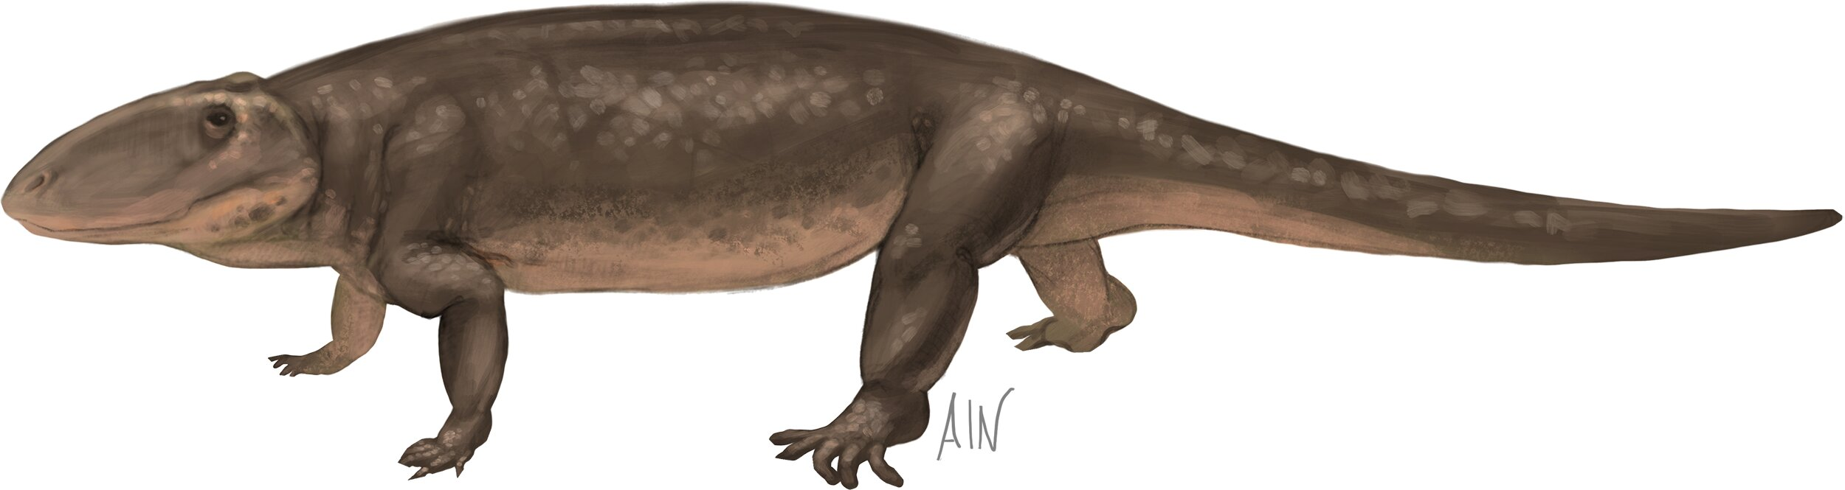
The Evolution of the Cortex
The Therapsid Gamble – Energy for Flexibility
Early mammal ancestors traded efficiency for adaptability.
They burned more energy to stay active and aware.
Flexibility, not power, became the key to survival.
Notes:
Around 250 million years ago, a lineage of reptile-like creatures called therapsids began to take an extraordinary evolutionary gamble.
They increased their metabolism, became warm-blooded, and began to regulate their body temperature internally.
This wasn’t just a physiological change—it was a strategic one.
By staying warm, they could remain active when other creatures slowed down or fell dormant.
They could forage, escape, and hunt in the cool darkness of night.
But energy is expensive, and this new lifestyle came with enormous costs.
Therapsids had to eat constantly.
They needed efficient digestion, quick reflexes, and precise sensory systems to make the most of every calorie.
That pressure began to favor brains that could avoid mistakes.
Wasting energy on trial and error—on bumping into obstacles or chasing impossible prey—could mean starvation.
Evolution thus started rewarding flexibility and prediction rather than brute force.
Therapsids that could anticipate, plan, and strategize had the edge.
Their world demanded not just speed, but foresight—an internal capacity to simulate what might happen before it did.
And over time, those small advantages—thinking a little faster, hesitating before acting, choosing better paths—added up.
In a dangerous, competitive world, a little imagination went a long way.

Slide 9
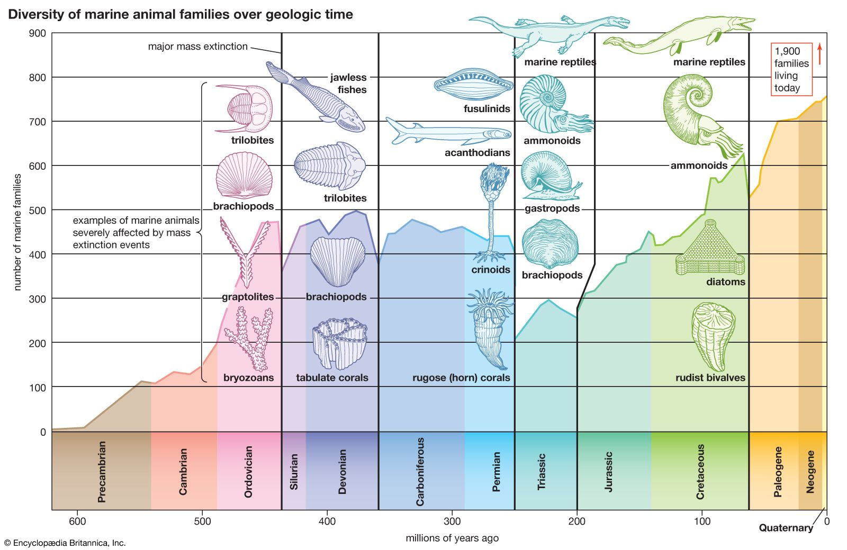
The Evolution of the Cortex
Surviving the Permian Extinction
When most species vanished, flexibility became everything.
Therapsids with adaptive minds endured catastrophe.
Cognition was born in crisis.
Notes:
Roughly 252 million years ago, Earth experienced the worst mass extinction in its history—the Permian extinction.
Volcanic eruptions, climate chaos, and collapsing food webs wiped out around ninety percent of all species.
It was not strength or size that determined who survived, but flexibility.
Organisms that could tolerate change, shift habits, and exploit new opportunities made it through.
Among the few vertebrate survivors were the therapsids, the warm-blooded reptiles that would eventually give rise to mammals.
Their internal heat allowed them to stay active when the world turned cold and unpredictable.
But even more crucially, their evolving nervous systems gave them behavioral flexibility.
They could explore new food sources, new hunting times, and new habitats.
They didn’t just react to change—they could adapt their behavior to it.
In that crucible of catastrophe, natural selection began favoring minds that could model the world’s volatility rather than simply endure it.
The ability to anticipate uncertainty, to imagine different possibilities, and to adjust actions accordingly became the ultimate survival trait.
Cognition didn’t evolve in times of stability—it evolved in times of chaos.
The extinction didn’t just prune life’s tree; it sharpened the minds of those that remained.

Slide 10
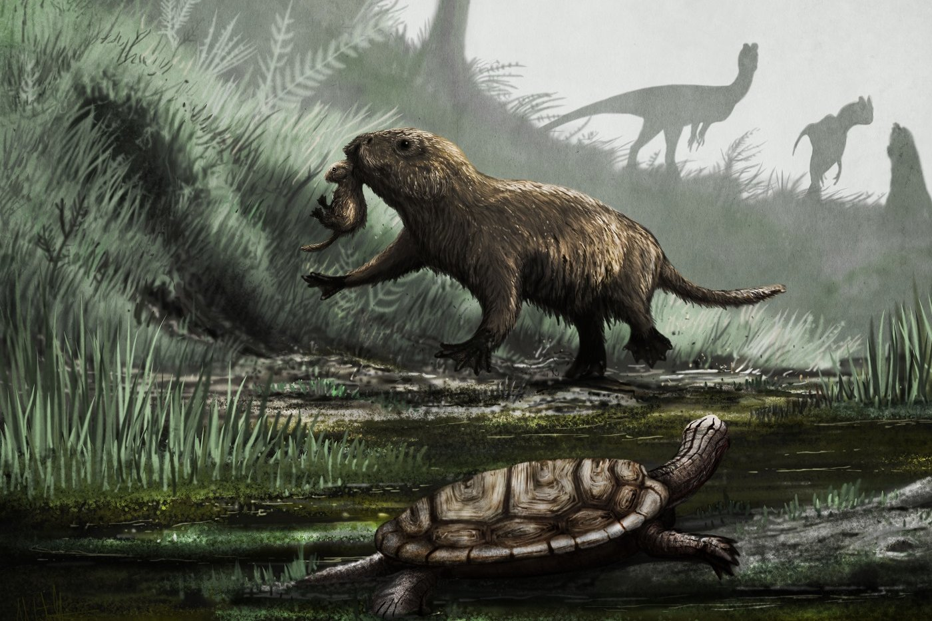
The Evolution of the Cortex
The Rise of Nocturnal Mammals
In a dinosaur’s world, mammals survived by night.
Darkness favored quiet, cautious, imaginative brains.
Planning replaced brute force.
Notes:
After the Permian extinction, reptiles once again came to dominate the planet.
The Mesozoic world was ruled by dinosaurs—fast, strong, and often enormous.
Our small mammalian ancestors were forced into the margins of that world, taking refuge in the dark.
They became nocturnal, burrowing, and elusive—living lives of constant vigilance.
In the darkness, vision faltered, and with it the simple stimulus–response strategies that had worked so well for reptiles.
A flash of movement or a glint of light was no longer enough to guide behavior.
To navigate safely, these early mammals needed to piece together the world from memory, sound, smell, and touch.
They needed to form an internal model—a mental map they could explore when external cues were missing.
Nocturnality also changed the economics of risk.
A reptile could afford a mistake in broad daylight, but a small mammal venturing into the open night could not.
One wrong movement could mean death.
Trial and error became too costly, forcing mammals to evolve a new strategy: trial and error in the mind.
They began to “think ahead,” to pause, to imagine different possibilities before acting.
In a sense, imagination was a defense mechanism—a way to survive when you couldn’t afford to experiment.
What began as an adaptation for navigating darkness would become the basis of every form of higher cognition to come: foresight, planning, creativity, and thought itself.

Slide 11
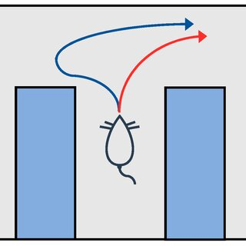
The Evolution of the Cortex
The Gift of the First Move – Planning Before Acting
Reptiles learned by doing.
Mammals could also learn by imagining doing.
Simulation let them choose the best action before committing to it.
“Vicarious Trial and Error”
Notes:
For hundreds of millions of years, the only way to learn was to act and see what happened.
A fish learns which turns lead to food only by swimming them.
A lizard learns which prey to chase only after catching or missing it.
This is model-free learning—direct reinforcement of behavior by its outcome.
It works, but it’s slow, risky, and often wasteful.
Early mammals broke that mold.
They began to construct an internal simulation of the world
—a space where actions could be tested without their real-world consequences.
Instead of swimming every possible path,
the mammal could imagine a few in its mind and choose the best.
This new way of learning—vicarious trial and error—was safer, faster, and vastly more efficient.
Imagine two animals facing a fork in the road.
The reptile simply picks one path and learns from the reward or punishment it receives.
The mammal pauses, hesitates, and mentally “runs” both routes,
predicting which one will lead to food or safety.
The result is not just a better decision in the moment
—it’s a foundation for learning that generalizes,
allowing the animal to apply past experience to new situations.
This innovation transformed behavior from reactive to proactive.
Animals were no longer bound to the immediate present.
They could entertain possibilities, plan sequences, and adapt flexibly to change.
Simulation turned the brain into an engine of imagination
—a device for predicting the future before committing to it.

Slide 12
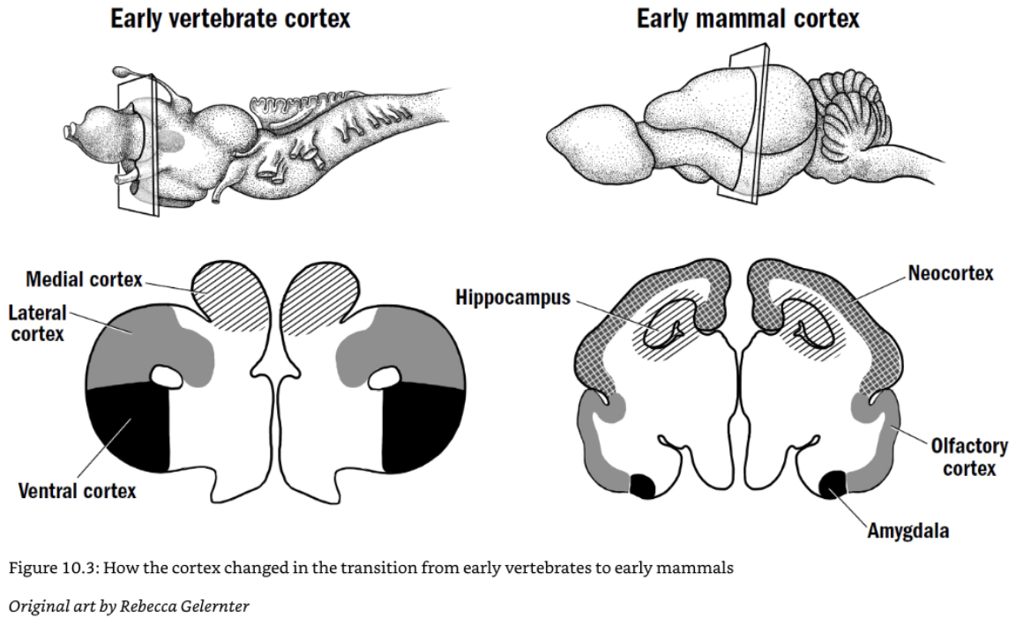
The Evolution of the Cortex
The Birth of the Neocortex
A new cortical layer changed everything.
The neocortex added flexible, general-purpose computation.
It allowed animals to model the world, not just sense it.
Notes:
The biological breakthrough that made simulation possible was the emergence of a new structure—the neocortex.
Earlier vertebrates had only a three-layered “paleocortex,” suited for basic sensory processing and simple associations.
But mammals evolved an expanded, six-layered neocortex, capable of richer and more flexible computation.
This structure wasn’t specialized for any single sense or function.
It was a kind of general-purpose prediction engine
—able to take in patterns from any modality and learn how they change over time.
In one species, it might process visual shapes; in another, auditory rhythms or tactile layouts.
In every case, the same circuitry learned to recognize regularities,
fill in missing information, and anticipate what would come next.
That flexibility was the secret.
The neocortex could simulate—generate internal patterns of activity that mirrored real experiences.
It could create a “what if” version of the world, run it forward,
and compare the imagined outcome with reality.
Over evolutionary time, this ability became the foundation of recognition, imagination, and memory.
It was the first brain structure not tied to any single behavior or domain,
but capable of constructing a general world model.
The neocortex didn’t evolve to ponder philosophy or invent technology.
Its original job was far humbler and more urgent:
to let small mammals survive in a world dominated by giants.
By predicting before acting, they could outthink rather than outfight their predators.
The neocortex gave them not just faster reactions—but foresight.

Slide 13
The Evolution of the Cortex
From Learning by Doing →
Learning by Imagining
Reptiles learned through experience.
Mammals began to learn from simulated experience.
The brain could now run experiments inside itself.
Notes:
For most of evolutionary history, learning meant acting first.
An animal had to try something—move, bite, flee
—and let reinforcement teach it whether the choice was good or bad.
This was the logic of the basal ganglia: strengthen what worked, weaken what didn’t.
It was an elegant system, but painfully inefficient.
Every lesson required risk, time, and energy.
Mammals found a shortcut.
With the rise of the neocortex, brains began to construct internal models of their environments.
They could simulate possible futures, test them mentally,
and update their expectations without needing to perform the action in reality.
This was learning by imagining.
In reinforcement learning terms, we would say the brain moved from “model-free” to “model-based.”
Instead of simply reacting to feedback, mammals learned to predict feedback in advance.
They could choose actions based not on what had happened, but on what might happen.
That made learning exponentially faster and safer
—especially for small, vulnerable creatures navigating dangerous, unpredictable worlds.
This change was revolutionary.
It meant that evolution no longer had to hardwire every behavior,
and that individual experience no longer had to be earned through trial and error.
A single brain, through imagination alone, could rehearse countless possibilities.
For the first time in history, an organism could improve its behavior in its mind before ever trying it out in the world.

Slide 14
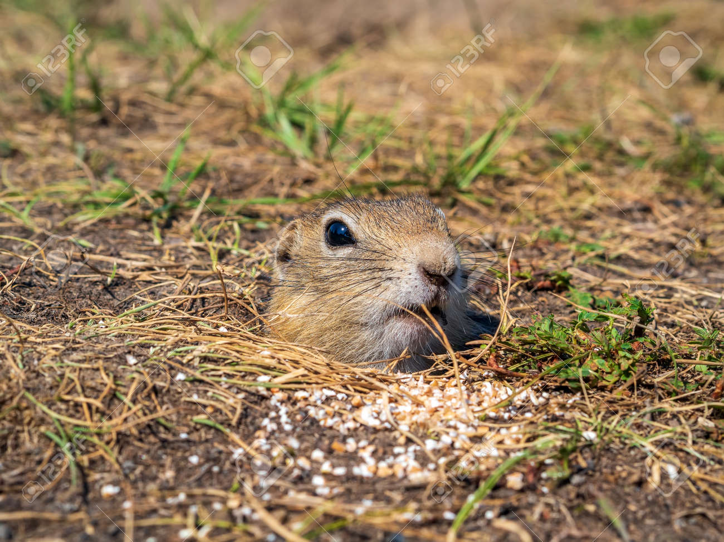
The Evolution of the Cortex
Why Simulation Was an Evolutionary Breakthrough
Simulation solved the limits of trial-and-error learning.
It made learning faster, safer, and more flexible.
Thinking became an evolutionary shortcut.
Notes:
Simulation was not just a clever trick—it was a profound leap in the logic of learning itself.
Trial-and-error learning, while effective, has strict limits.
It’s costly, because every mistake happens in the real world.
It’s slow, because feedback only comes after action.
And it’s narrow, because it only reinforces what has actually been tried.
Animals that relied on it could adapt only within the boundaries of their direct experience.
Simulation changed those rules.
By imagining possible futures, mammals could explore thousands of actions virtually
before committing to one physically.
They could evaluate options that had never been experienced,
compare outcomes that hadn’t yet occurred, and avoid actions that would lead to disaster.
This made them not just faster learners, but fundamentally different kinds of learners.
It also opened the door to abstraction.
A simulated world can represent not only things that exist, but things that could exist
—plans, strategies, and hypothetical situations.
An animal that can simulate can generalize, transferring knowledge from one context to another.
It can test “what if” scenarios, reason about causes, and even invent solutions.
In evolutionary terms, this meant that thought itself became a form of natural selection
—ideas could compete inside the mind before actions competed in the world.
Simulation made cognition recursive: brains could learn from their own models.
And that recursive loop—imagining, predicting, revising—became the defining hallmark of mammalian intelligence.

Slide 15
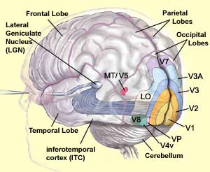
The Evolution of the Cortex
Vision as a Gateway to Simulation
Many senses can support imagination.
But vision offered a natural foundation for internal modeling.
Its spatial structure made prediction possible.
Notes:
Imagination isn’t limited to sight—we can picture sounds, movements, even abstract ideas.
But in evolutionary history, vision likely provided the first and most natural foundation for simulation.
That’s because vision organizes information spatially.
It builds a map-like representation of the world, showing not only what’s here now, but what lies beyond the edge of perception.
Those spatial regularities—shapes, distances, trajectories—lend themselves perfectly to prediction.
They allow a brain to model how things will move, appear, or disappear as the animal moves through space.
For early mammals, this was invaluable.
Their nocturnal lives meant they often had to act on incomplete visual information.
They had to infer the position of prey, obstacles, or predators from hints and memory, reconstructing what they couldn’t see directly.
That kind of perceptual inference—filling in gaps—was an early form of mental simulation.
Over time, the same cortical machinery that predicted visual patterns became useful for predicting any pattern: sounds, movements, outcomes, or events.
The neocortex generalized the skill from “seeing the unseen” to “imagining the unexperienced.”
So while imagination today draws on every sense and every kind of thought, vision may have provided the first scaffolding—a way for the brain to rehearse the future using the same circuits that once only saw the present.

Slide 16
The Evolution of the Cortex
Bigger Brain
Faster Thinking
Better Predictions
More Food
More Energy
Warm Brains = Fast Computation
Warm-bloodedness sped up neural processing.
Fast neurons made predictive thinking possible.
Energy fueled foresight.
Endothermy
Notes:
When mammals evolved warm-bloodedness, they didn’t just change how they regulated temperature
—they changed how fast their brains could think.
Neurons operate through electrochemical reactions that depend on temperature.
Cooler brains, like those of reptiles, transmit signals more slowly,
meaning their reactions are limited by environmental warmth.
A cold lizard’s brain literally slows down.
By maintaining a steady, high body temperature, mammals freed themselves from that limitation.
Their neurons could fire rapidly and synchronously,
enabling complex chains of processing to unfold in milliseconds.
They could integrate multiple sensory inputs, update predictions on the fly,
and coordinate fine movements in real time.
Warm-bloodedness turned cognition from a stop-motion process into continuous film.
But this came with immense energetic costs.
The mammalian brain is a voracious organ—it consumes about 20% of a human’s resting energy.
That means evolution had to make every spike, every calculation, count.
Brains that could predict effectively wasted less energy on failed actions and inefficient learning.
Simulation was not just an advantage—it was an energy-saving strategy.
It let mammals rehearse outcomes internally rather than burning calories on trial and error.
So while we often think of imagination as a luxury of consciousness,
it may have begun as an energy efficiency hack.
A faster brain had to be a smarter brain
—one that used foresight to conserve the precious fuel that made speed possible.

Slide 17
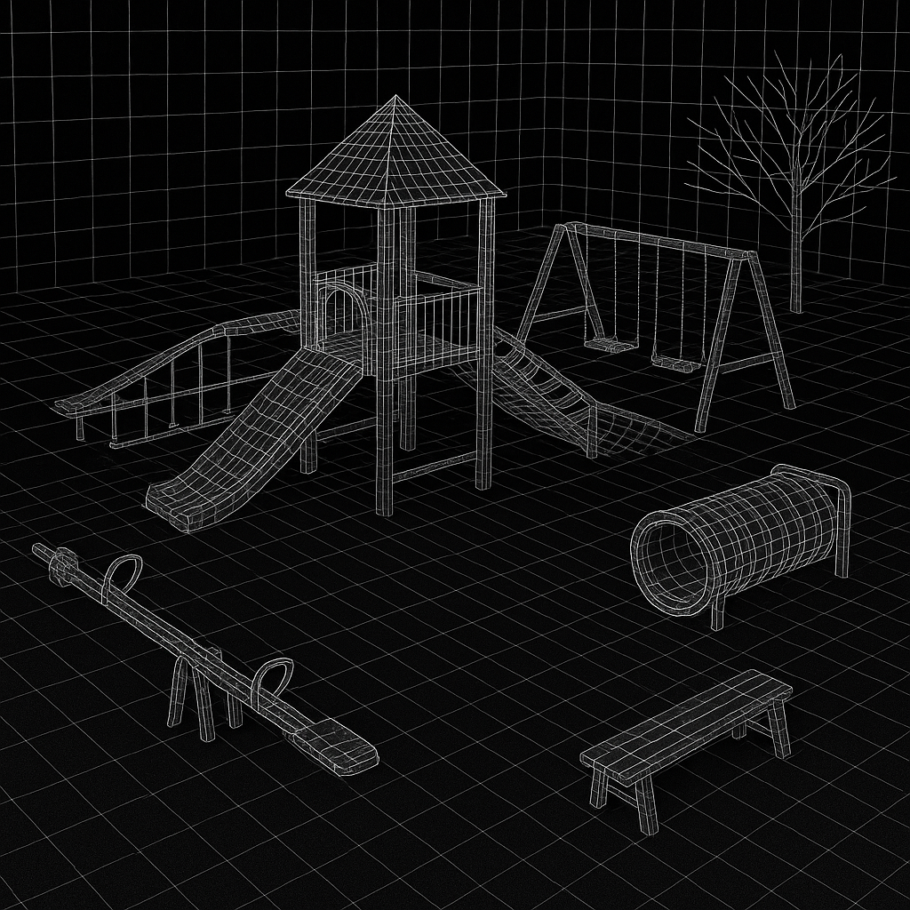
The Evolution of the Cortex
The Third Great Predictive Leap: World Models
Reflexes predicted milliseconds.
Reinforcement predicted seconds.
World models let brains predict minutes, hours, and beyond.
Notes:
Across evolution, intelligence has advanced through extensions of prediction.
Each major step in brain design pushed the horizon of foresight a little further into the future.
Reflex circuits—the simplest kind of brain—could predict almost nothing.
They responded instantly to stimuli, anticipating events only a few milliseconds ahead: a touch, a flash, a sound.
When vertebrates evolved reinforcement learning, they added a new kind of prediction—reward through time.
Their brains could now link actions with delayed outcomes, anticipating pleasure or pain seconds or minutes later.
This allowed pursuit, avoidance, and habit formation, but still only within immediate experience.
The third leap came with mammals and their neocortex.
Their brains could simulate the environment itself—how objects move, how places connect, how events unfold.
This was the first world model: an internal map that could be updated, explored, and used to guide action far beyond the present moment.
It allowed animals to plan paths through space, anticipate social interactions, and imagine future scenarios hours or days ahead.
Each layer of brain evolution didn’t replace the previous one—it built on it.
Reflexes still handled split-second responses.
Reinforcement circuits still managed motivation and reward.
But the new cortical system added something qualitatively different:
the ability to run mental simulations detached from the here and now.
For the first time, the brain wasn’t just reacting to reality—it was constructing it.
This expansion of predictive scope—from moments to models—was the cognitive big bang that made mammalian intelligence possible.

Slide 18
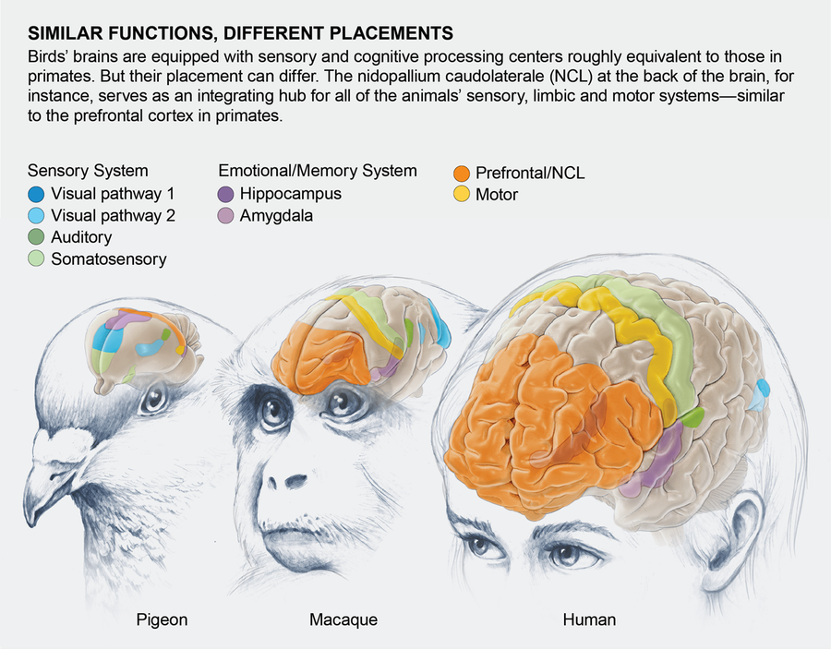
The Evolution of the Cortex
Birds – A Parallel Evolution of Warm-Blooded Thought
Endothermy evolved twice—and so did foresight.
Birds built their own simulation machinery.
Different anatomy, same computational solution.
Notes:
It’s important to remember that mammals weren’t the only lineage to make this leap.
Birds, too, evolved warm-bloodedness—and with it, the metabolic freedom to sustain rapid, continuous neural processing.
Their brains run hot, literally and figuratively, enabling fast reactions, long attention spans, and flexible learning.
But birds didn’t copy the mammalian blueprint.
Their brains lack a neocortex; instead, they evolved a different structure—the pallium—that performs many of the same functions.
This is a striking example of convergent evolution: two very different anatomical designs solving the same computational problem.
Like mammals, birds built world models—they could learn, predict, and even imagine outcomes before acting.
Today we see that capacity most clearly in corvids and parrots.
Crows plan multi-step tool use, remember the what–where–when of past events, and even anticipate future hunger.
Songbirds rehearse their songs silently in their brains before they sing—an unmistakable form of internal simulation.
In essence, birds turned flight into a metaphor for thought: light, fast, and endlessly adaptive.
So, while our story centers on the mammalian lineage, the deeper pattern is broader.
Whenever evolution created a fast, warm, energy-rich brain, it also discovered simulation.
Endothermy, it seems, is the spark that makes imagination possible.

Slide 19
The Evolution of the Cortex
World Models
Hebbian & Reinforcement Learning
Reflex Arcs
Reflex → Reward → World Prediction
Reflexes react.
Reinforcement learns from outcomes.
World models imagine outcomes before they happen.
Notes:
We can now see three major stages in the evolution of prediction, each building on the last.
The first stage—reflexes—involves simple, hardwired reactions.
A sudden movement or touch triggers an immediate response: withdraw, strike, or flee.
These systems are fast and reliable but completely inflexible.
They predict only the next instant, and they cannot learn from experience.
The second stage—reinforcement learning—added plasticity.
Here, animals could adjust their behavior based on feedback from the environment.
The brain learned which actions led to good or bad outcomes, storing that knowledge as habits.
This was a huge step forward, allowing creatures to adapt to new circumstances and develop preferences.
But reinforcement learning is still limited to past experience.
It cannot imagine situations that have not yet occurred.
The third stage—world modeling—freed cognition from that constraint.
A world model doesn’t just react or recall—it simulates.
It lets the brain run internal experiments, projecting possible futures and choosing among them.
In modern neuroscience, these three systems still coexist:
the spinal cord and brainstem handle reflexes,
the basal ganglia manage reward learning,
and the neocortex builds predictive models of the world.
Together they form a hierarchy of foresight.
Reflexes look ahead milliseconds, reinforcement circuits seconds, and the cortex—potentially hours, days, or even years.
This growing temporal reach is what made mammals capable of planning, anticipation, and imagination.
It marks the transition from reactive brains to predictive minds.

Slide 20
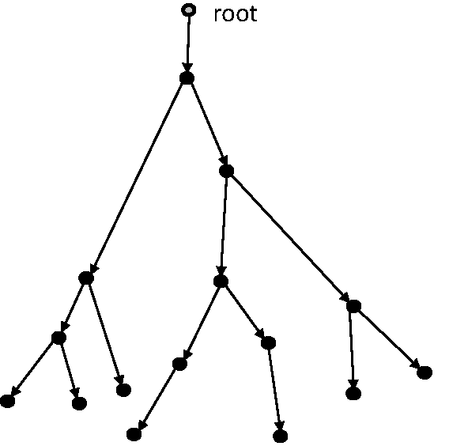
The Evolution of the Cortex
Functional Payoffs – Planning, Exploration, and Learning from Absence
Simulation made action smarter, not faster.
Mammals could plan routes, test ideas, and learn from what didn’t happen.
Imagination expanded the meaning of experience.
-3
+8
-7
+9
+7
-5
+2
Notes:
The practical benefits of simulation were enormous.
For the first time, animals could plan—not simply react to obstacles, but anticipate them.
They could chart routes through space, test sequences of actions in their minds, and select the most efficient or safest path before moving.
This ability to mentally “look ahead” turned navigation, hunting, and foraging into strategic acts rather than blind searches.
Simulation also enabled exploration.
A creature with a world model could imagine unseen opportunities—food around a corner, shelter over a ridge—and be motivated to seek them out.
This drove curiosity, a behavior that seems frivolous but is deeply adaptive.
Exploring imagined possibilities helps animals discover real resources before necessity forces them to.
Even more remarkably, mammals could learn from non-events—from what didn’t happen.
A rat that takes a risky path but imagines an alternative can update its behavior even without directly experiencing the consequence.
In the language of learning theory, they can assign credit or blame to hypothetical outcomes.
That’s something a reflexive or purely reinforcement-based brain could never do.
These abilities changed the very structure of experience.
Instead of learning only from direct feedback, mammals began learning from simulated feedback.
Instead of waiting for failure to teach them, they could imagine failure and avoid it altogether.
Every act of imagination became a small experiment, expanding the reach of cognition without the cost of real-world trial and error.
In evolutionary terms, simulation turned time itself into an ally.
Animals could practice the future in their heads long before it arrived.

Slide 21
The Evolution of the Cortex
Bigger Brain
Faster Thinking
Better Predictions
More Food
More Energy
Energy Trade-Offs and Metabolic Costs
Prediction is expensive.
Brains burn enormous energy to imagine futures.
But foresight saves more energy than it spends.
Endothermy
Notes:
Warm-blooded mammals gained speed and flexibility, but these came at a steep metabolic price.
The mammalian brain is one of the most energy-hungry organs in nature—pound for pound, it burns more calories than any muscle.
Every neuron firing, every simulated scenario, costs glucose and oxygen.
From an evolutionary standpoint, that’s a serious investment.
So why didn’t natural selection favor smaller, cheaper brains?
Because foresight pays for itself.
Each accurate prediction saves energy that would otherwise be spent on unnecessary movement, failed hunts, or avoidable danger.
A brain that can imagine a bad outcome before acting prevents the waste of calories that would come from making that mistake in reality.
In that sense, the neocortex acts as an internal laboratory—an expensive tool that more than earns its keep.
We can think of this as an energy economy of thought.
Trial-and-error learning requires physical effort; imagination replaces that with computation.
Running mental simulations may be metabolically costly, but compared to running for your life, it’s cheap.
Over millions of years, natural selection optimized brains not for minimum energy use, but for maximum efficiency of learning.
This is one reason mammals—and eventually primates—could evolve such large brains.
Once the ability to predict and plan existed, bigger brains didn’t just consume more energy; they conserved it through smarter behavior.
Imagination made intelligence self-reinforcing: the more energy a species invested in thought, the more energy it saved by thinking well.

Slide 22
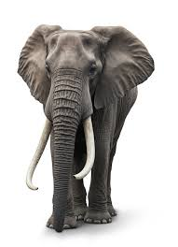
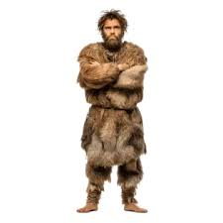
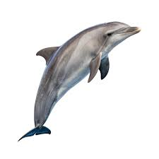
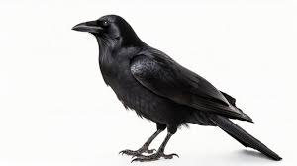
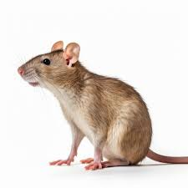
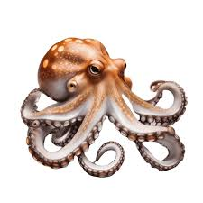
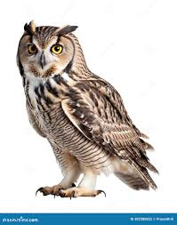
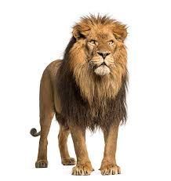
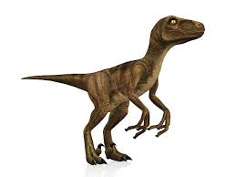
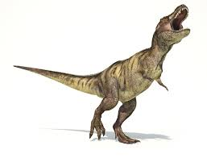
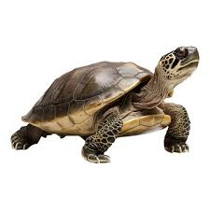
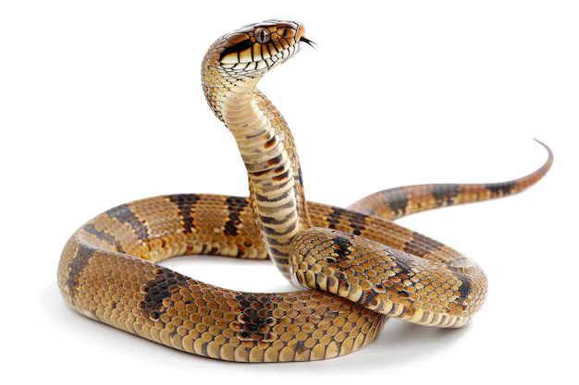
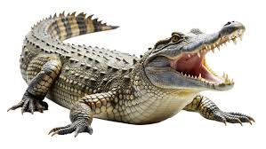
The Evolution of the Cortex
Simulation as a New Cognitive Niche
Mammals didn’t outfight their rivals—they outthought them.
Simulation became a new ecological strategy.
Thinking was a way of surviving.
Think
Fight
Notes:
By the late Mesozoic era, mammals had found a completely new way to compete
—not through size, armor, or speed, but through anticipation.
While dinosaurs dominated the open landscapes, mammals carved out a different niche: the cognitive one.
They hunted, foraged, and raised young in the margins, relying on stealth and foresight rather than brute strength.
This was a quiet revolution in evolutionary strategy.
Their greatest weapon was their ability to model the world inside their heads.
Simulation let them exploit situations their rivals couldn’t.
A mammal could imagine where prey might move next, when a predator would reappear, or how the weather might shift.
They could navigate complex social dynamics, remember routes, and plan coordinated behaviors.
All these capacities arose from the same core ability: running internal scenarios to guide real action.
Over time, this mental flexibility became its own ecological niche—what we might call the “cognitive niche.”
Species that could model, predict, and plan had access to a new dimension of survival.
Instead of evolving sharper claws, they evolved better strategies.
Instead of outcompeting others physically, they outmaneuvered them mentally.
Even today, the same principle applies:
Brains exist not just to react to the world, but to simulate it.
Every thought, every decision, every flash of insight is an act of internal modeling.
That niche—thinking as survival—was born in small, nocturnal mammals dodging the shadows of dinosaurs.
It’s the niche humans still occupy, though on a vastly grander scale.

Slide 23
The Evolution of the Cortex
Creativity
Imagination
Prediction
Learning
From Survival to Imagination – The Seed of Mind
Imagination began as a survival tool.
But once brains could simulate the world, they could imagine anything.
Survival gave rise to creativity.
Notes:
The first mammals didn’t imagine for pleasure or creativity—they imagined to stay alive.
Their mental simulations were practical: predicting danger, testing strategies, and avoiding mistakes.
But once the capacity for simulation existed, it no longer had to stay tied to survival.
A brain that can model the world can also recombine it
—forming new scenarios, new ideas, and new possibilities that have never existed.
This is one of the most remarkable transitions in evolution.
A mechanism built for navigation and planning became the foundation for art, language, and abstract thought.
The same circuits that once imagined where a predator might be now imagine the future, the past, and the unreal.
Imagination stopped being a means to an end—it became an end in itself.
From a functional perspective, this is what sets mammals apart.
Once brains could simulate events and entities,
they could begin to simulate internally generated concepts
—stories, goals, plans, even moral possibilities.
That flexibility didn’t just make individuals smarter; it made entire species capable of cultural evolution.
Thoughts could now be tested, shared, and refined without immediate consequences, just like actions once were.
So when we speak of imagination as the hallmark of mind,
we’re tracing a lineage that began as an adaptive trick in small, nocturnal animals.
From those mental rehearsals grew reflection, creativity, and reasoning—the full flowering of cognition.
What began as survival in the dark became, over time, the light of consciousness itself.

Slide 24
The Evolution of the Cortex
Recap
Simulation let mammals act without trial and error.
It turned experience into imagination and foresight.
Up Next
How the brain implements this miracle of prediction.
Notes:
We’ve seen how simulation arose as an evolutionary solution to life’s oldest problem:
how to act in an uncertain world without first making fatal mistakes.
By imagining outcomes before acting, early mammals learned faster, took smarter risks, and survived where others couldn’t.
That simple functional change—learning by imagining—became the foundation for memory, planning, and ultimately consciousness.
But so far, we’ve been talking at the level of why.
In our next lecture, we’ll move to the level of how.
What kind of process makes simulation possible?
How can a system take raw sensory input, build an internal model of the world, and use that model to predict what will happen next?
We’ll explore the algorithms of imagination—how the brain (and modern AI systems) use generative models, prediction errors, and counterfactual reasoning to make sense of experience.
If Lecture 1 was about the evolutionary birth of thought, Lecture 2 is about its machinery—the computational logic that turns perception into prediction.

